Slide 1
Accelerating Your OFFER
-- Machine Learning Practice to Speed Up Application Process
Siyuan Bai, Nan Liao, Lichen Kuai, Bingle Wu, Wenxiao Wu

Slide 2
Data Preprocessing--Cleaning
Sample Job Description
Company Name
"Company Overview\n\n\nAt Memorial Sloan Kettering (MSK), we’re not only changing the way we treat cancer, but also the way the world thinks about it. By working together and pushing forward with innovation and discovery, we’re driving excellence and improving outcomes. For the 28th year, MSK has been named a top hospital for cancer by U.S. News & World Report. We are proud to be on Becker’s Healthcare list as one of the 150 Great Places to Work in Healthcare in 2018, as well as one of Glassdoor’s Employees’ Choice Best Place to Work for 2018. We’re treating cancer, one patient at a time. Join us and make a difference every day.\n\nJob Description:
·······
\n\nYou will:\nSupport agile team in translating end user requirements into set of user product criteria for technical development team & developing documentation\nConnect with team to confirm product commitments\nConduct data analysis and research required for development team to make decisions\nCollaborate with team to understand, analyze, document, and communicate platform requirements\nPartner with key stakeholders to articulate and refine product vision throughout the iteration process\nHelp design team in translating product needs/requirements into deliverable units of work\nAble to synthesize metrics such as: user satisfaction/adoption, quality of products delivered, time-to-market, timely delivery etc···
Job Title (JT)
Normalizing JT into 4 Categories:
Business Analyst
Data Analyst
Data Scientist
Data Engineer
Job Description (JD)
Removing Unnecessary Words/ Sentences
Sentence with Company Name
Sentence with [‘we’, ‘our’]…
Line/ Tab Characters
Symbols
Data Preprocessing
LDA Model
Random Forest
Application
Validation

Slide 3

Data Preprocessing– Feature Mapping I
A Set of Words that contains all the Technical Skills and Tools for Data Related Jobs
tool_keywords = set(['python', 'pytorch', 'sql', 'mxnet', 'mlflow', 'einstein', 'theano', 'pyspark', 'solr', 'mahout',
'cassandra', 'aws', 'powerpoint', 'spark', 'pig', 'sas', 'java', 'nosql', 'docker', 'salesforce', 'scala', 'r',
'c', 'c++', 'net', 'tableau', 'pandas', 'scikitlearn', 'sklearn', 'matlab','keras', 'tensorflow', 'clojure’,…])
skill_keywords = set(['statistics', 'chatbot', 'cleaning', 'blockchain', 'causality', 'correlation', 'bandit', 'anomaly', 'kpi',
'dashboard', 'geospatial', 'ocr', 'econometrics', 'pca', 'gis', 'svm', 'svd', 'tuning', 'hyperparameter', 'hypothesis',
'salesforcecom', 'segmentation', 'biostatistics', 'unsupervised', 'supervised’,…])
Stem Words within the Sets
Intersect Two Set to Obtain a Vector of Feature for Each of the Company
Tokenize the Words within the String then Stem Each Word
Job Description
Data Preprocessing
LDA Model
Random Forest
Application
Validation

Slide 4
LDA Model– Feature Mapping II
Input of the Models
Expected Output
For each of the Job Title
For each of the Job Title
Topic 1:
Job Description (JD)
10 Words with their Probabilities
Tokenize the JD & Count Each Word’s Frequency
LDA
Topic 2:
10 Words with their Probabilities
Remove the Top 500 Commonly Appeared Words
Topic 3:
Remove the Bottom 100 Commonly Appeared Words
10 Words with their Probabilities
Data Preprocessing
LDA Model
Random Forest
Application
Validation

Slide 5
LDA Model– Model Output
Business Analyst
'decision', 'medical', 'procurement', 'physical', 'collaboration', 'judgment', 'quantitative', 'operating', 'skillsstrong', 'party', 'input', 'feedback', 'common'…
LDA_DA +
LDA_DE
LDA_BA +
LDA_DS +
Data Analyst
LDA_List
+
'accuracyadept', 'reportsdevelop', 'setsfilter', 'qualityacquire', 'problemswork', 'bull', 'analyststrong', 'needslocate', 'opportunities', 'flow', 'clearance'…
Pervious Vector From the Research List
Data Scientist
=
'statistical', 'machine', 'learning', 'analytic', 'scientist‘, 'predictive', 'techniques', 'algorithms', 'visualization', 'machine', 'statistical', 'quantitative', 'techniques', 'programming'…
Final Features
Data Engineer
'etl', 'python', 'pipelines', 'big', 'azure', 'engineer', 'aws', 'warehouse', 'bi', 'learning', 'big', 'hadoop', 'azure', 'spark', 'programming', 'python', 'streaming'…
Mapping for each of the Company Job Description to Obtain a New Vector
Data Preprocessing
LDA Model
Random Forest
Application
Validation

Slide 6
Random Forest – Model Constructions
Construct a Random Forest Model for Each of the Job Title
Business Analyst
Data Analyst
Data Scientist
Data Engineer
Business Analyst
Data Analyst
Data Scientist
Data Engineer
1000 Job Description (JD) from current category : Labeled as 1
330 Job Description (JD) from other categories Labeled as 0
Dependent variables (Y): Job Title
Sample Training Data for the Model:
Y = 1 / 0
X = [0.345723, 0.567823,0.7264, 0.13765, …]
Independent variables (X): Vectors from Previous Steps
Model Input
70:30 Training-Testing Splitting
Transforming Words Vectors into Numerical Vectors:
Create Bag of Words for Each of the Model
For each word, 0 – nonexistence, 1– existence
Transform the matrix using TF-IDF
Form into a Numerical Vector for each of Job Posting
Data Preprocessing
LDA Model
Random Forest
Application
Validation

Slide 7
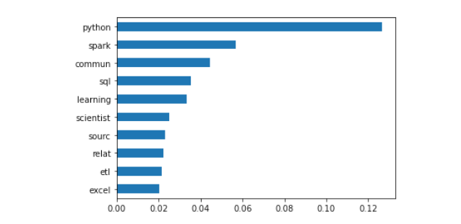
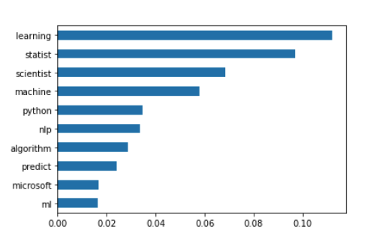
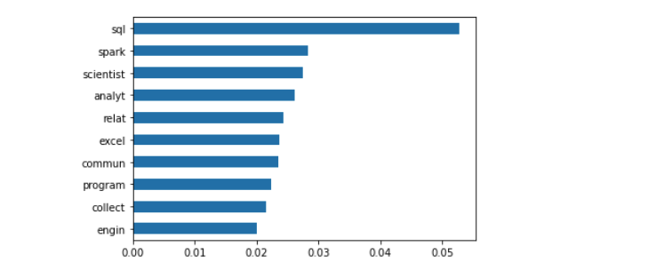
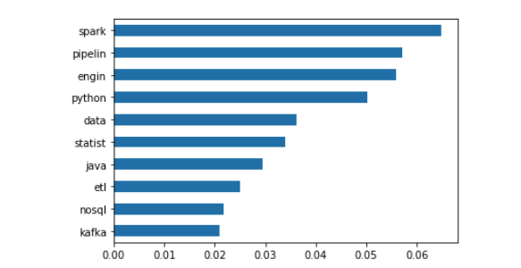
Random Forest – Model Output
Business Analyst
Data Scientist
Accuracy Score:
Accuracy Score:
86%
90%
Data Analyst
Data Engineer
Accuracy Score:
78%
Accuracy Score:
90%
Data Preprocessing
LDA Model
Random Forest
Application
Validation

Slide 8
Model Application
Sample Implementation I
Sample Implementation II -- Misclassification
Input
Input
Company: Intel Corporation
Job Title: Data Scientist
Job Description: Our team invents next-generation "AI for Security" solutions to detect cyber threats using Intel CPU features and machine learning techniques Solutions developed by our team have been deployed in over a billion systems.\n\nWe are seeking a motivated Data Scientist to research and develop innovative, industry-leading Machine Learning (ML)-based….
Company: Citi
Job Title: Data Analyst
Job Description: This AVP Data Analyst role supports LATAM Markets, a regional franchise that has Sales & Trading teams in 21 countries. The Data Analyst role is responsible for working closely with our Business, Technology and Innovation teams to originate impactful data use cases and increase data literacy across our business….
Output
Output
Summarization:
Summarization:
Python
Engine
Statist
Program
Machine
ML
Commun
Engine
Statist
Predict
Machine
Pipeline
BA
BA
DA
DA
DS
DS
DE
DE
Data Preprocessing
LDA Model
Random Forest
Application
Validation

Slide 9
Validation – User Study
Summarization Evaluation
Result
1. On a scales 1-5: How would you rate the summarization?
***Each Participant was given 10 random summarization during the survey
1 (Does not Match)
2
The Summarization Obtain an Average of 4.2 / 5.0
3
4
5 (Very Match)
2. On a scales of 1-5: Would you like to have the summarization
during the recruiting process?
About 90% of the Participants Would Like to Use the Summarization. (Rate 4 and above)
1 (Does not Match)
2
3
4
5 (Very Match)
Able to Hugely Cut Down Reading Time of Summarization
Data Preprocessing
LDA Model
Random Forest
Application
Validation

Slide 10
THANKS

